Slide 1


Aayush Keshari · Nipun Chandra · Shivam Kharangate
Interface critique and redesign target
Finding classes and enrolling with confidence
CATALYST

Slide 2
AGENDA
    What Catalyst does
    Task 1: Find a class
    Task 2: Enroll in a class
    Navigation and recovery
    Visual design
    Redesign priorities and validation

Slide 3
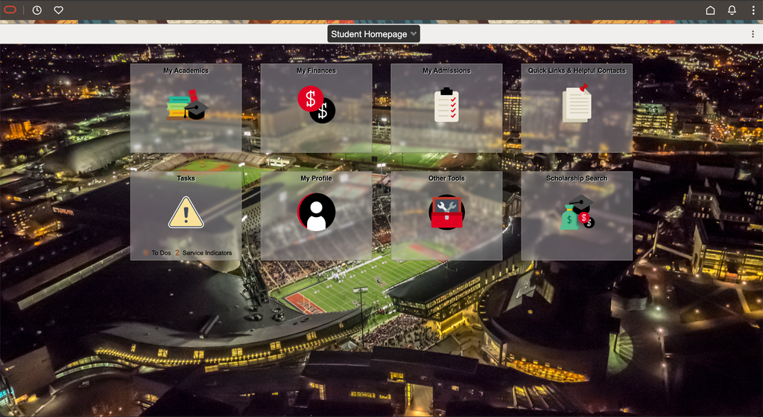
WHAT CATALYST DOES
UC'S STUDENT PORTAL
Academic and administrative tasks in one portal, grouped into areas such as My Academics, My Finances and Tasks.
CRITIQUE FOCUS
Class search and enrollment

Slide 4
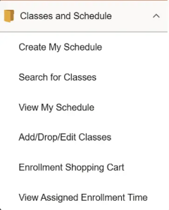
TASK 1: FIND A CLASS
01
Open My Academics
02
Choose Classes and Schedule
03
Search for Classes
04
Set criteria and inspect a section
GOAL
Compare sections without rebuilding the search.

Slide 5
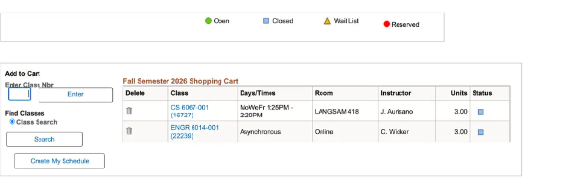
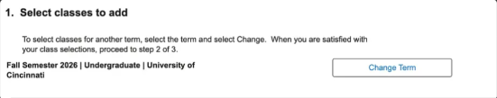
TASK 2: ENROLL IN A CLASS
01
Add a section to the cart
02
Complete enrollment when eligible
THE CART HOLDS SELECTED SECTIONS
03
Review the result
04
Verify your class schedule
WATCH FOR
Planning, the cart, and enrollment are separate states to understand.
A SAVED SELECTION DOES NOT RESERVE A SEAT

Slide 6

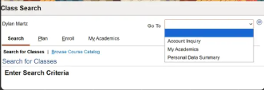
NAVIGATION INCREASES THE LEARNING BURDEN
SIMILAR LABELS, DIFFERENT DESTINATIONS
UNPREDICTABLE RETURN PATHS
Students must remember which menu or tool performs each action.
Reported back-button loops and lost filters interrupt comparisons.
LEARNABILITY: RECOGNITION, CONSISTENCY, AND USER CONTROL

Slide 7
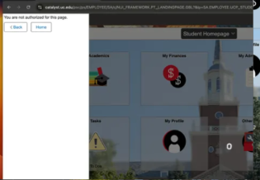
RECOVERY CAN BECOME ANOTHER TASK
REPORTED IN THE CLASS CRITIQUE
    Favorites and history can lead to loops
    Unexpected logout has unclear recovery
    Prerequisite errors lack useful detail
    Wrong Duo code can leave the screen stuck
“YOU ARE NOT AUTHORIZED FOR THIS PAGE.”
A useful error explains the cause and offers the next action.
Behavior reports need reproduction. The authorization message is visible in the supplied .

Slide 8
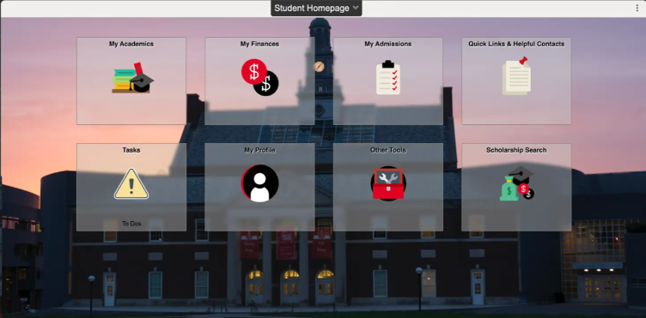
THE VISUAL DESIGN COMPETES WITH THE TASK
01
Busy photo behind translucent tiles
02
Small labels, little urgency hierarchy
03
Reported overflow on resize
Keep the recognizable categories and large click targets.

Slide 9
REDESIGN PRIORITIES
01
02
03
COMPLETE THE WORKFLOW
PREVENT AND EXPLAIN ERRORS
IMPROVE SCANNING
Connect search, comparison, cart, and enrollment.
Validate fields early and give specific recovery steps.
Prioritize deadlines with clear text and a calmer layout.
WHY IT MATTERS
WHY IT MATTERS
WHY IT MATTERS
Preserve context and clarify status.
Reduce avoidable retries.
Make important actions easier to find.

Slide 10
WHAT A SUCCESSFUL REDESIGN SHOULD PROVE
STUDENTS SHOULD UNDERSTAND THE NEXT STEP AND KNOW WHEN THE TASK IS COMPLETE.
HEURISTIC REVIEW + THINK-ALOUD TASKS
Observe completion, wrong turns, repeated inputs, and understanding of enrollment status.
THEN COMPARE
The prototype against the current workflow, using the same two tasks.

Slide 11
THANK YOU
Questions?

